Slide 1

DEBUGGING BACKEND WITH VS2017

Slide 2
AGENDA
Introduction to Debugging
How to Debug using VS2017
Breakpoints
Conditional Breakpoints
Debug Windows
Remote Debugging

Slide 3
WHAT IS DEBUGGING?
The process of finding and resolving defects or problems within a computer program that prevent correct operation of computer software or a system.

Slide 4

IMPORTANCE OF DEBUGGING
Perfect code is an illusion
Legacy code
Deeper understanding
Helps you learn & write better code in the future

Slide 5
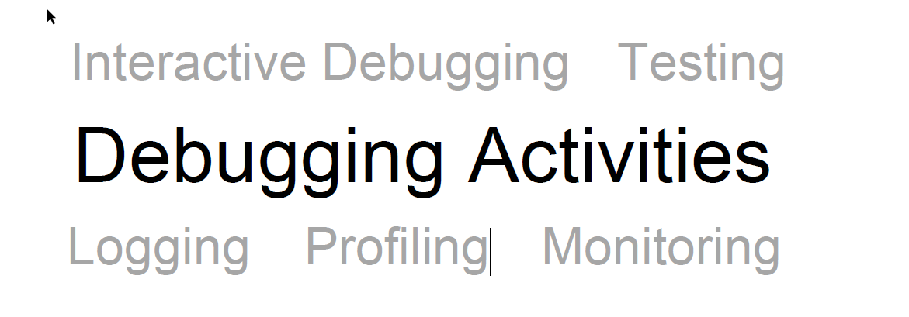

Slide 6
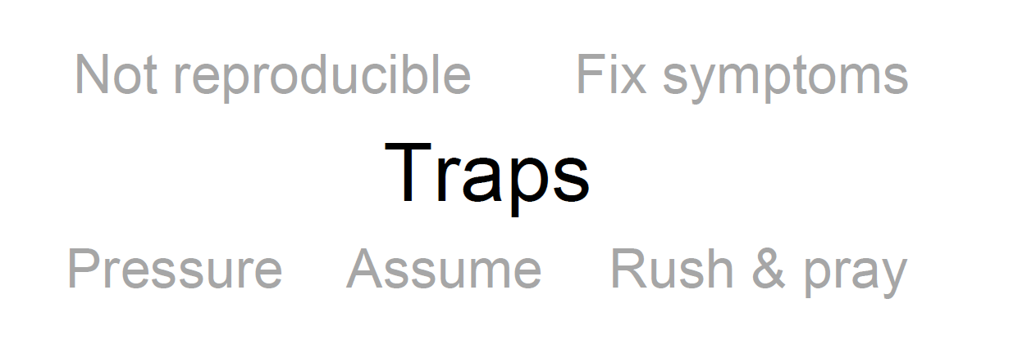

Slide 7
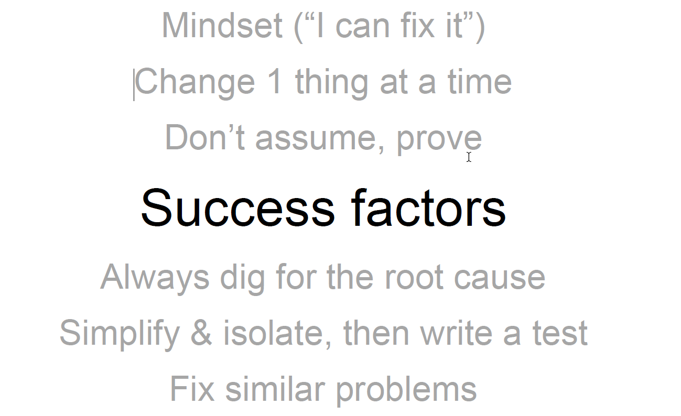

Slide 8
DEMO..
Visual Studio 2017 Highlights
Navigate code in the debugger
BreakPoints
Conditional BreakPoints
Run to click navigation
Inspect variables with data tips
Auto
Local
Watch
Examine call stack
Change execution flow

Slide 9
EXERCISE
Intent for this code is to display the galaxy name, the distance to the galaxy, and the galaxy type all in a list.
Here is the format for one line from the list that we want to show in the output:
galaxy name, distance, galaxy type.

Slide 10
DEMO..
PDB Files
Process/Remote Debugging

Slide 11
And,
Your Turn..
QUESTIONS?
Let’s Roll…

